Slide 1



Learn Programming Online
Embark on a coding journey with our interactive platform. Unlock your potential and master programming. Start building your future today.
By CodeCrafter

Slide 2

Project Objective: Empower Learners
Our platform aims to democratize coding education. We strive to make learning accessible and engaging. We want to empower individuals globally. Learn at your own pace and reach your goals.
Accessibility
Engagement
Empowerment
Available to anyone.
Fun and interactive.
Unlock potential.

Slide 3




Key Features: Interactive Learning
Interactive coding exercises and real-time feedback provided. Project-based learning for practical application. Comprehensive course library for skill development.
Coding exercises
Project based
Course library
Real-time feedback.
Practical applications.
Skill development.
`

Slide 4




System Diagram: Modular Design
Frontend handles user interaction and presentation. Backend manages data and logic using API connections. Database stores user data and course content.
Frontend
User interaction.
Backend
Data management.
Database
Data storage.

Slide 5
Tools and Technologies
We chose modern and scalable technologies. React for the frontend and Python backend. PostgreSQL database ensures data integrity. Cloud deployment for accessibility.
Frontend: React
Backend: Python
Database: PostgreSQL
Deployment: Cloud
Interactive UI.
Scalable API.
High Availability.
Data integrity.

Slide 6
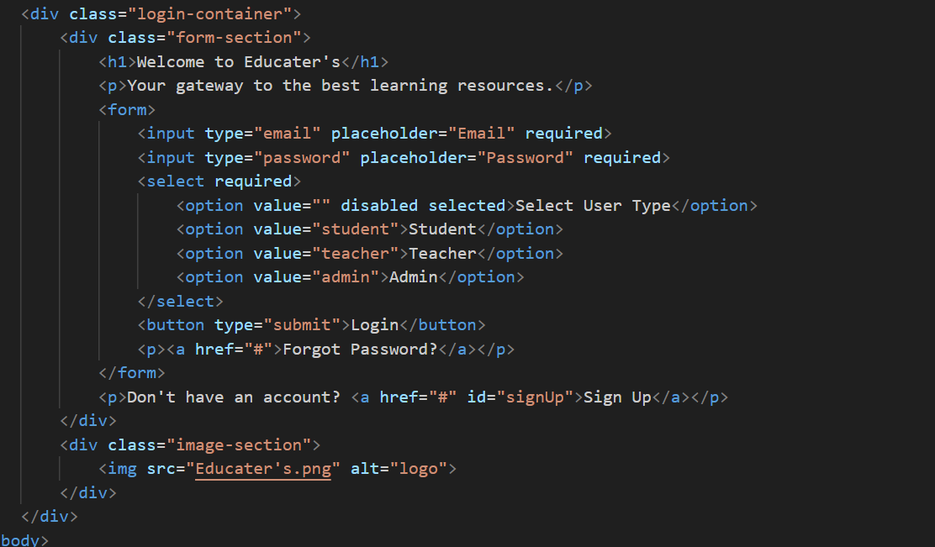
Proof of Output: Working Code
Functional prototype showcasing core features. User authentication and course enrollment are working. Interactive code editor with real-time feedback.

Slide 7
Advantages & Disadvantages
Advantages
Disadvantages
Accessible
Requires internet
Scalable
Management costs
Interactive

Slide 8

Scope and Conclusion
Our project aims to provide accessible education. Initial scope focuses on core coding concepts. Future scope includes advanced topics.
1
Initial Scope
Coding Concepts
2
Future Scope
Advanced Topics

Slide 9



Evaluation Criteria Alignment
Our platform aligns with key educational goals. Accessibility, engagement, and skill development. We are committed to measurable outcomes for users.
1
Skill development
2
Engagement
3
Accessibility
The foundation of our strategy ensures accessibility.

Slide 10

Thank You!
We appreciate your time and attention. Any questions or comments are welcome. Join us on this exciting journey.

